Slide 1



Slide 2


Slide 3


Slide 4


Slide 6



Slide 7


Slide 8




PineApple Computer
Works
Think Difficult.
marowattz485

Slide 9
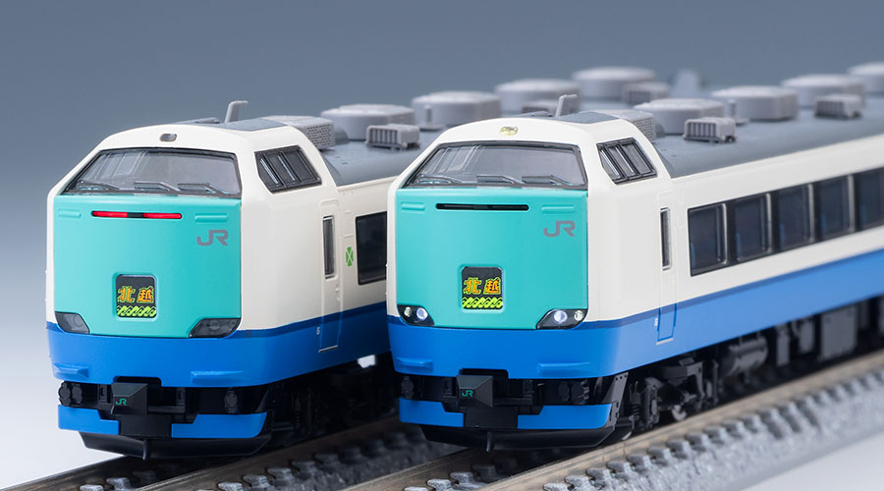
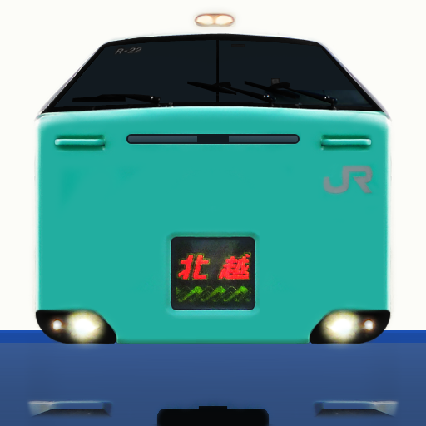


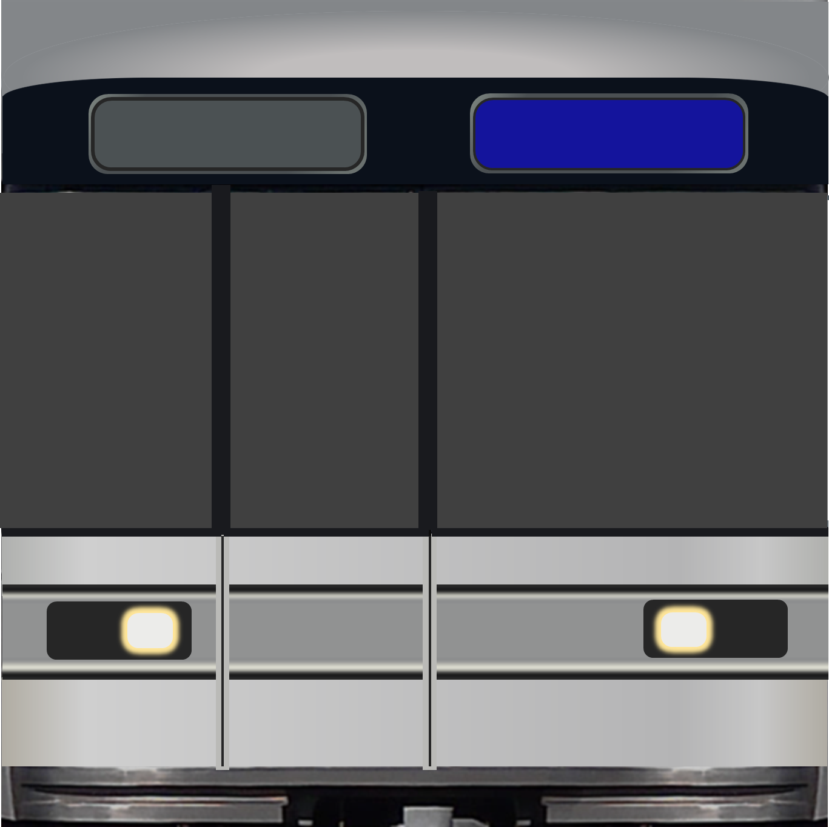
Think Difficult.
PineApple Computer
パイナップル
モデルズ
PineApple
Models

Slide 10
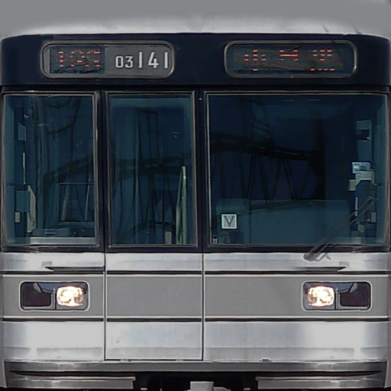




Slide 11

